Slide 1
Tips for Marketing Your FCD CLASS
Jim peacock and Mark Danaher
Notes:
Introduction

Slide 2
OUtline
Who is your audience?
What is your brand?
Networking in the right places
Using social media
Paying for advertising
Conferences
Questions & Answers
What topics would you like to see in future webinars for FCD-Instructors?
Notes:
Poll #1 How many FCD classes have you taught so far?
none
1-5
5-10
10+
How do you deliver the class?
all online using a video conferencing platform (like Skype, Zoom, etc…)
Hybrid (some live F2F and online)
All “live”
Who is your primary audience?
Higher Education
K-12
Workforce Development
Business
Human Resources
Military
Private Practitioners
Counselors
General / anyone

Slide 3

Who is YOUR AUDIENCE?

Slide 4


branding

Slide 5

Networking in the right places
Notes:
IN CHAT:
Poll #2 MARK: if we can’t do a “fill in the blank”, lets just have them answer this in the chat area
Where are places you go to network? or “How do you expand your network?”
How do you keep your network alive?”

Slide 6

USING SOCIAL MEDIA
Notes:
Go to Jim’s Google Docs

Slide 7

PAID ADVERTISING
Notes:
Poll #3 Advertising
If you have advertised your FCD class, where have you advertised?
Google ads
Facebook ads
Conferences
Local papers
Professional Associations (websites, newsletters, etc..)
other

Slide 8

Notes:
FRONT

Slide 9

Notes:
BACK of card

Slide 10


Slide 11

CONFERENCES
WHAT OTHERS DO YOU ATTEND?

Slide 12
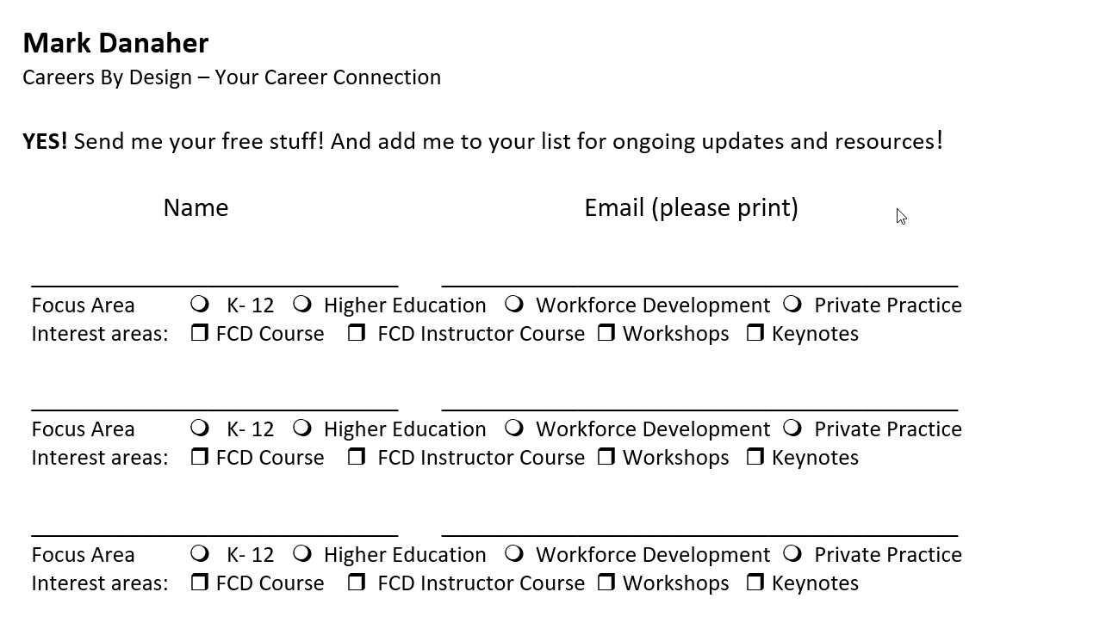
SAMPLE PRESENTATION SIGN UP

Slide 13


Slide 14

What topics would you like to see in future webinars for FCD Instructors?

